Slide 1


Slide 2


Slide 3


Slide 4


Slide 5


Slide 6

Exploring Movie Data Analytics: Visualizing Ratings, Budgets, and Box Office Earnings
Theo Demetriou
Ayesha Abeyakoon
Jun Kah Yong
Deldata Musa

Slide 7

During a time of data unrest, it is pivotal that we maintain data ethics. Our Readme section is designed to include guidelines and information of how our data is handled, managed and used within the project. It was important to use the data responsibly to avoid bias or discrimination .
Data was stored in a json output file (and every attempt made to stop it being stolen by the Empire)
“Pursued by the Empires Sinister agents” Ayesha, Deldata, Jun and Theo race back home to brief their class on their project …….( “and to restore freedom to the galaxy”) …………..

Slide 8


Slide 9
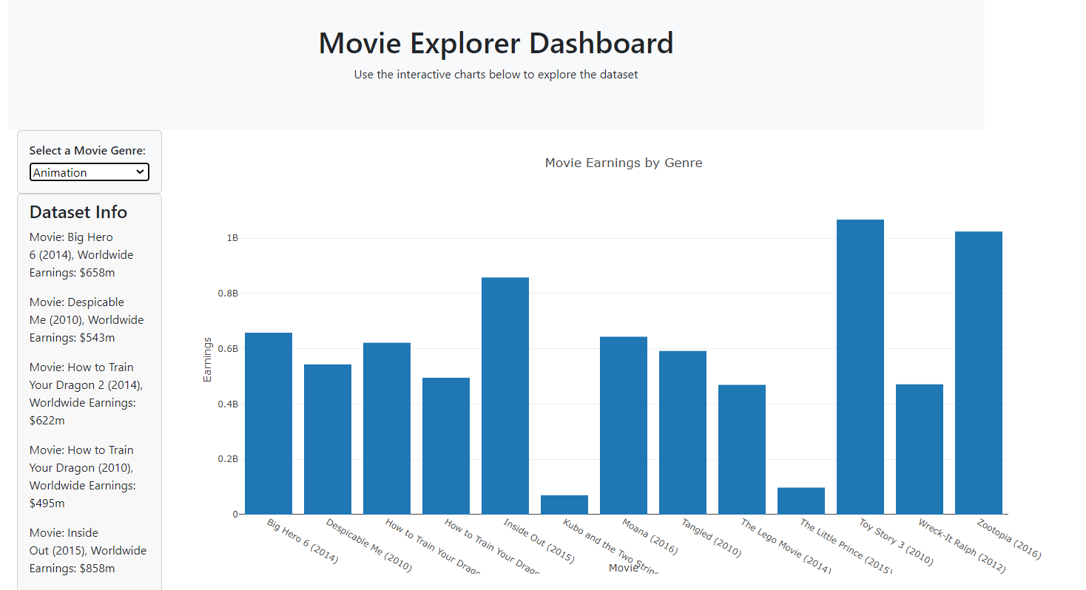
Presented by
Abeyakoon (Ayesha) Karunadhipathi
Visualisation:
Clustered column bar chart
Key components:
X axis: Movie titles
Y axis: Worldwide Earnings
Key insights:
Action - Highest earnings: Star Wars: The Force Awakens (2015)
Animation - Highest earnings: Toy Story (2010)
Adventure - Highest earnings: The Hobbit: An Unexpected Journey (2012)
Biography – Highest earnings: The Kings Speech (2010)
Comedy – Highest earnings: La La Land (2016)
Crime – Highest earnings: Gone Girl (2014)
Mystery – Highest Earnings: Shutter Island (2010)
Highest earnings overall: Star Wars: The Force Awakens (2015)

Slide 10
Presented by
Abeyakoon (Ayesha) Karunadhipathi
Visualisation:
Clustered column bar chart
Key components:
X axis: Movie titles
Y axis: Worldwide Earnings
Key insights:
Action - Highest earnings: Star Wars: The Force Awakens (2015)
Animation - Highest earnings: Toy Story (2010)
Adventure - Highest earnings: The Hobbit: An Unexpected Journey (2012)
Biography – Highest earnings: The Kings Speech (2010)
Comedy – Highest earnings: La La Land (2016)
Crime – Highest earnings: Gone Girl (2014)
Mystery – Highest Earnings: Shutter Island (2010)
Highest earnings overall: Star Wars: The Force Awakens (2015)

Slide 11

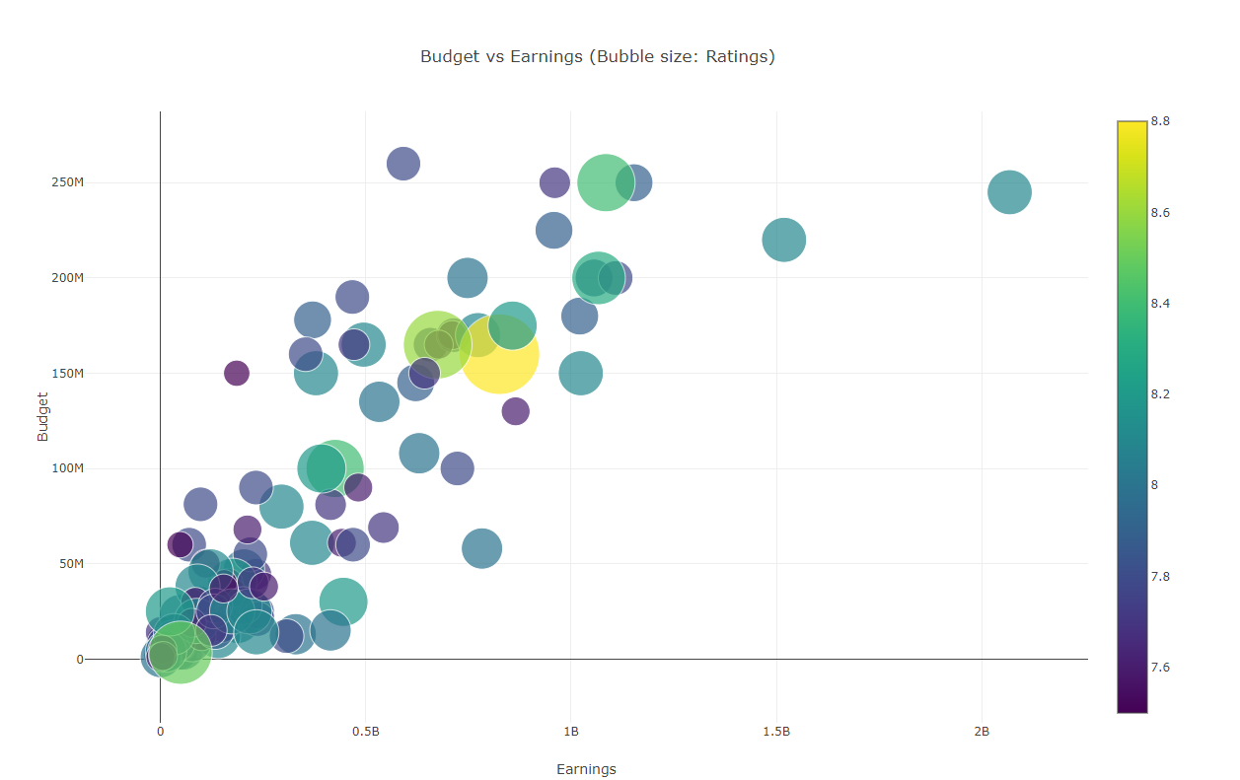
Presented by
Theo Demetriou
Visualisation:
Bubble Chart
Key components:
X axis: Earnings
Y axis: Budget
Bubble size: Ratings
Key insights:
Highest earnings overall: Star Wars: The Force Awakens (2015)
Highest rating: Interstellar shown in yellow. Received 8.8 stars out of 10 by IMDB.
Movies around the top left are loss making. For instance the Budget for ‘The Warrior’ exceeds the Worldwide earnings, thus meaning it made a loss.

Slide 12
Presented by
Theo Demetriou
Visualisation:
Bubble Chart
Key components:
X axis: Earnings
Y axis: Budget
Bubble size: Ratings
Key insights:
Highest earnings overall: Star Wars: The Force Awakens (2015)
Highest rating: Interstellar shown in yellow. Received 8.8 stars out of 10 by IMDB.
Movies around the top left are loss making. For instance the Budget for ‘The Warrior’ exceeds the Worldwide earnings, thus meaning it made a loss.

Slide 13
Presented by
Theo Demetriou
Visualisation:
Bubble Chart
Key components:
X axis: Earnings
Y axis: Budget
Bubble size: Ratings
Key insights:
Highest earnings overall: Star Wars: The Force Awakens (2015)
Highest rating: Interstellar shown in yellow. Received 8.8 stars out of 10 by IMDB.
Movies around the top left are loss making. For instance the Budget for ‘The Warrior’ exceeds the Worldwide earnings, thus meaning it made a loss.

Slide 14
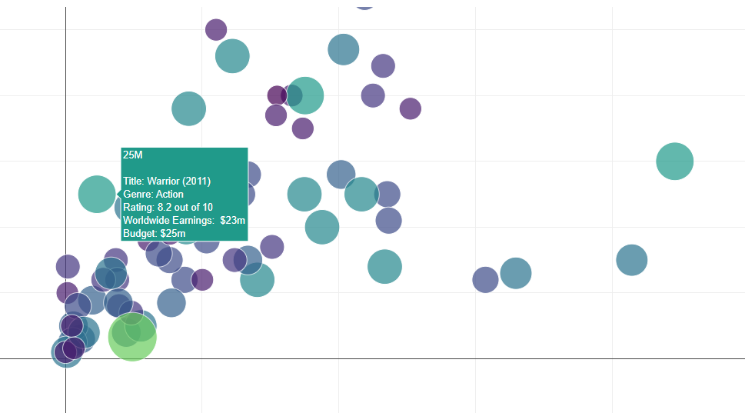
Presented by
Theo Demetriou
Visualisation:
Bubble Chart
Key components:
X axis: Earnings
Y axis: Budget
Bubble size: Ratings
Key insights:
Highest earnings overall: Star Wars: The Force Awakens (2015)
Highest rating: Interstellar shown in yellow. Received 8.8 stars out of 10 by IMDB.
Movies around the top left are loss making. For instance the Budget for ‘The Warrior’ exceeds the Worldwide earnings, thus meaning it made a loss.

Slide 15


Slide 16
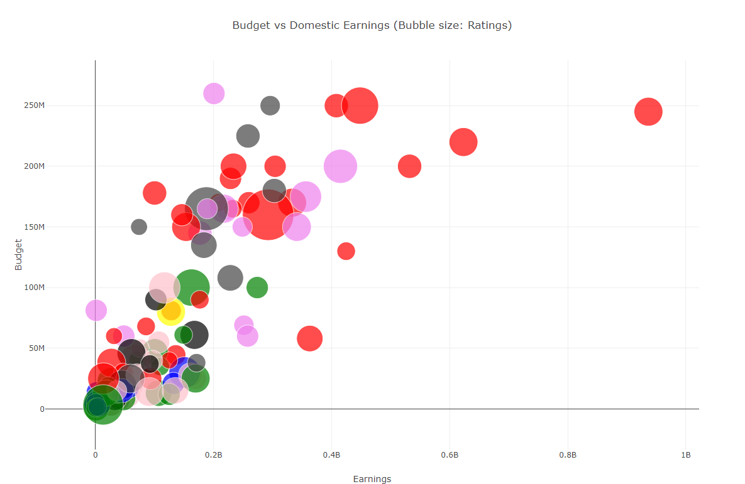
Presented by
Theo Demetriou
Visualisation:
Bubble Chart
Key components:
X axis: Earnings
Y axis: Budget
Bubble Size: Ratings
Bubble Color: Genre category
Key insights:
Action movies are shown in red and lead the way in terms of top earnings with high budgets
Adventure movies (grey) typically have high budgets however don’t perform as well as their action counterparts.
Animation movies perform moderately well when comparing earnings to budget.
The movie Tangled had a high budget but did not generate well in Domestic earnings.

Slide 17
Presented by
Theo Demetriou
Visualisation:
Bubble Chart
Key components:
X axis: Earnings
Y axis: Budget
Bubble Size: Ratings
Bubble Color: Genre category
Key insights:
Action movies are shown in red and lead the way in terms of top earnings with high budgets
Adventure movies (grey) typically have high budgets however don’t perform as well as their action counterparts.
Animation movies perform moderately well when comparing earnings to budget.
The movie Tangled had a high budget but did not generate well in Domestic earnings.

Slide 18
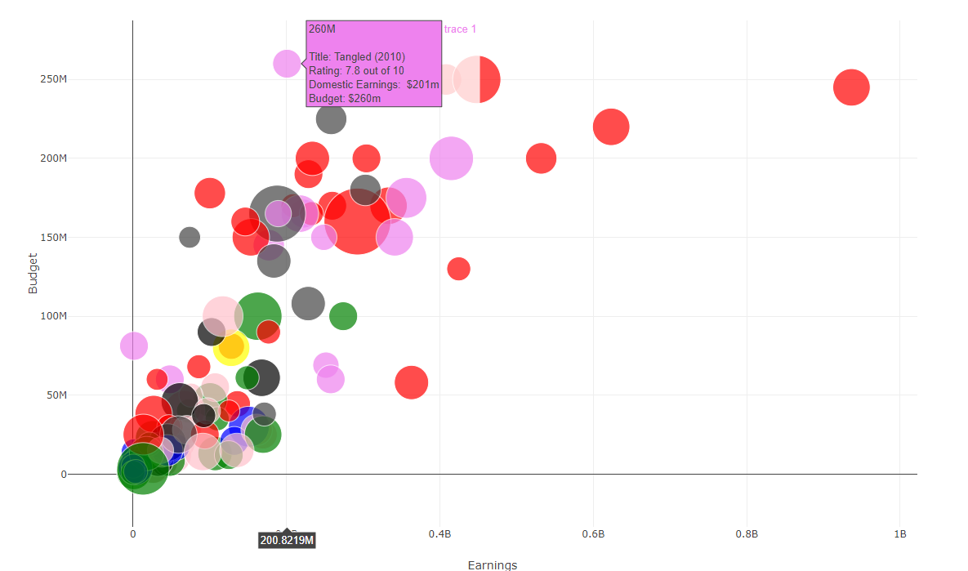
Presented by
Theo Demetriou
Visualisation:
Bubble Chart
Key components:
X axis: Earnings
Y axis: Budget
Bubble Size: Ratings
Bubble Color: Genre category
Key insights:
Action movies are shown in red and lead the way in terms of top earnings with high budgets
Adventure movies (grey) typically have high budgets however don’t perform as well as their action counterparts.
Animation movies perform moderately well when comparing earnings to budget.
The movie Tangled had a high budget but did not generate well in Domestic earnings.

Slide 19


Slide 20
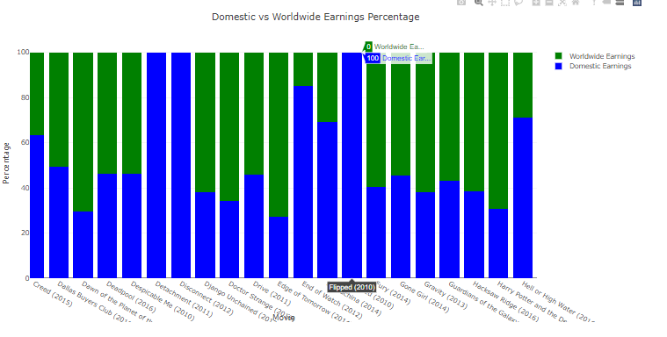
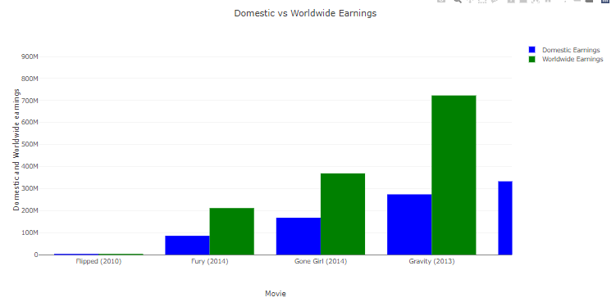
Presented by
Deldata Musa
Visualisation:
Domestic Vs Worldwide Earnings Percentage
(100% Stacked bar chart) (above)
Domestic vs Worldwide Earnings
(Clustered column bar chart) (below)
Key components:
X axis: Movie
Y axis: Percentage (Stacked) / Dollar split (Clustered columns) between Domestic and International Earnings
Color: As per legend (Worldwide = Green, Domestic = Blue)
Key insights:
Movies highlighted in all blue in the 100% stacked bar chart means that all earnings came from Domestic (US). This is shown in the movie ‘Flipped (2010)’ where Domestic equals Worldwide clustered column in the bottom chart.
Therefore, when Domestic earnings equal Worldwide earnings then no earnings have been made outside US.

Slide 21
Presented by
Deldata Musa
Visualisation:
Domestic Vs Worldwide Earnings Percentage
(100% Stacked bar chart) (above)
Domestic vs Worldwide Earnings
(Clustered column bar chart) (below)
Key components:
X axis: Movie
Y axis: Percentage (Stacked) / Dollar split (Clustered columns) between Domestic and International Earnings
Color: As per legend (Worldwide = Green, Domestic = Blue)
Key insights:
Movies highlighted in all blue in the 100% stacked bar chart means that all earnings came from Domestic (US). This is shown in the movie ‘Flipped (2010)’ where Domestic equals Worldwide clustered column in the bottom chart.
Therefore, when Domestic earnings equal Worldwide earnings then no earnings have been made outside US.

Slide 22

Presented by
Kah Jun Yong
Visualisation:
1 . Domestic Vs Worldwide Earnings
2. Metacritic vs IMDB votes
3 . Worldwide earnings by Metacritic votes
(Scatterplots)
Key components:
X-axis: Domestic earnings, Y axis: Worldwide earnings
X-axis: IMDB votes , Y axis: Metacritic votes
X-axis: Metacritic votes, Y axis: Worldwide earnings
Key insights:
Our key takeaway with scatterplots is to see if any relationship exists with the dataset.
Green scatterplot appears to have a strong linear relationship. In the Metacritic vs IMDB votes scatterplot, we would have to determine the correlation coefficient to determine what percentage the Metacritic voting (y-axis) is dependent on a change in the x axis being IMDB votes.
The appears to be no relationship between Worldwide earnings by Metacritic votes.

Slide 23
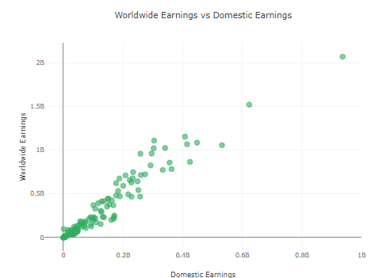
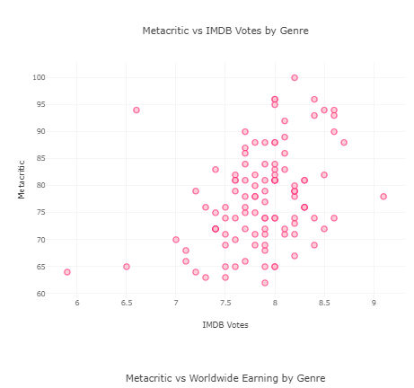
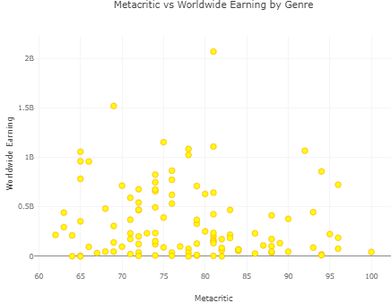
Presented by
Kah Jun Yong
Visualisation:
1 . Domestic Vs Worldwide Earnings
2. Metacritic vs IMDB votes
3 . Worldwide earnings by Metacritic votes
(Scatterplots)
Key components:
X-axis: Domestic earnings, Y axis: Worldwide earnings
X-axis: IMDB votes , Y axis: Metacritic votes
X-axis: Metacritic votes, Y axis: Worldwide earnings
Key insights:
In conclusion, our scatterplot analysis reveals key insights into the film industry. We find a strong correlation between worldwide and domestic earnings, indicating interdependence across markets. Assessing Metacritic and IMDB votes, we determine their relationship's strength quantitatively. Surprisingly, we discover no significant link between worldwide earnings and Metacritic votes, suggesting that critical acclaim may not always translate into financial success. These findings emphasize the multifaceted nature of movie performance and highlight the importance of data-driven insights for strategic decision-making in the industry.

Slide 24
Presented by
Kah Jun Yong
Visualisation:
1 . Domestic Vs Worldwide Earnings
2. Metacritic vs IMDB votes
3 . Worldwide earnings by Metacritic votes
(Scatterplots)
Key components:
X-axis: Domestic earnings, Y axis: Worldwide earnings
X-axis: IMDB votes , Y axis: Metacritic votes
X-axis: Metacritic votes, Y axis: Worldwide earnings
Key insights:
In conclusion, our scatterplot analysis reveals key insights into the film industry. We find a strong correlation between worldwide and domestic earnings, indicating interdependence across markets. Assessing Metacritic and IMDB votes, we determine their relationship's strength quantitatively. Surprisingly, we discover no significant link between worldwide earnings and Metacritic votes, suggesting that critical acclaim may not always translate into financial success. These findings emphasize the multifaceted nature of movie performance and highlight the importance of data-driven insights for strategic decision-making in the industry.

Slide 25


Slide 26
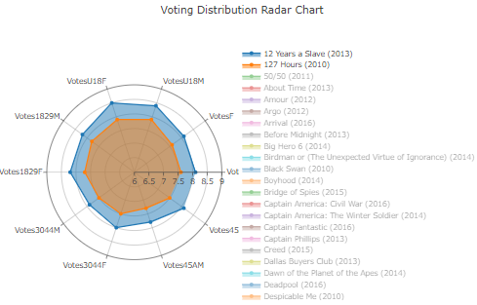
Presented by
Abeyakoon (Ayesha) Karunadhipathi
Visualisation:
Voting distribution radar chart
Key components:
Radius : Votes
Theta θ (Votes Male, Votes Female, Votes U18 Female, Votes U18 Male, Votes 18 to 29 Male, Votes 18 to 29 Female, Votes 30 to 44 Male, Votes 30 to 44 Female, Votes above 45 Male, Votes above 45 Female)
Key insights:
The voting radar chart allows us to compare movies individually and against each other.
We can see which groups of voters (defined by their grouping or by theta θ) votes for the movie out of 10. In the depicted chart “12 years a slave” polled better than “127 hours”.
The highest polling vote is the vote closest to the outer edge and inversely the vote closest to the middle has polled the least.

Slide 27
Presented by
Abeyakoon (Ayesha) Karunadhipathi
Visualisation:
Voting distribution radar chart
Key components:
Radius : Votes
Theta θ (Votes Male, Votes Female, Votes U18 Female, Votes U18 Male, Votes 18 to 29 Male, Votes 18 to 29 Female, Votes 30 to 44 Male, Votes 30 to 44 Female, Votes above 45 Male, Votes above 45 Female)
Key insights:
The voting radar chart allows us to compare movies individually and against each other.
We can see which groups of voters (defined by their grouping or by theta θ) votes for the movie out of 10. In the depicted chart “12 years a slave” polled better than “127 hours”.
The highest polling vote is the vote closest to the outer edge and inversely the vote closest to the middle has polled the least.

